Slide 1
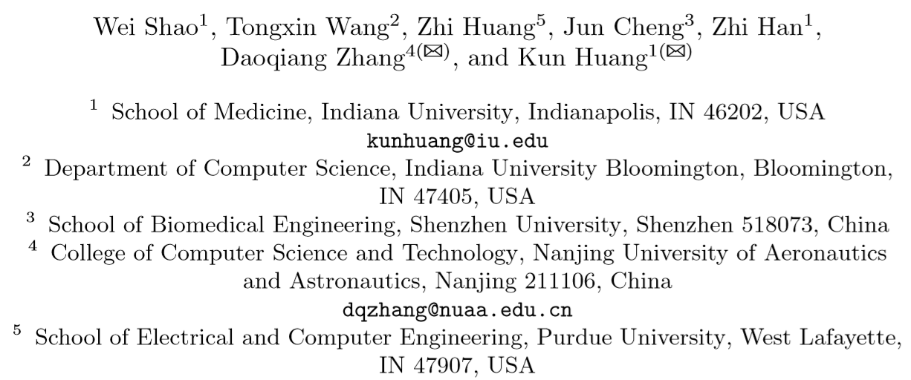
Diagnosis-Guided Multi-modal Feature Selection for Prognosis Prediction of Lung Squamous Cell Carcinoma

Slide 2
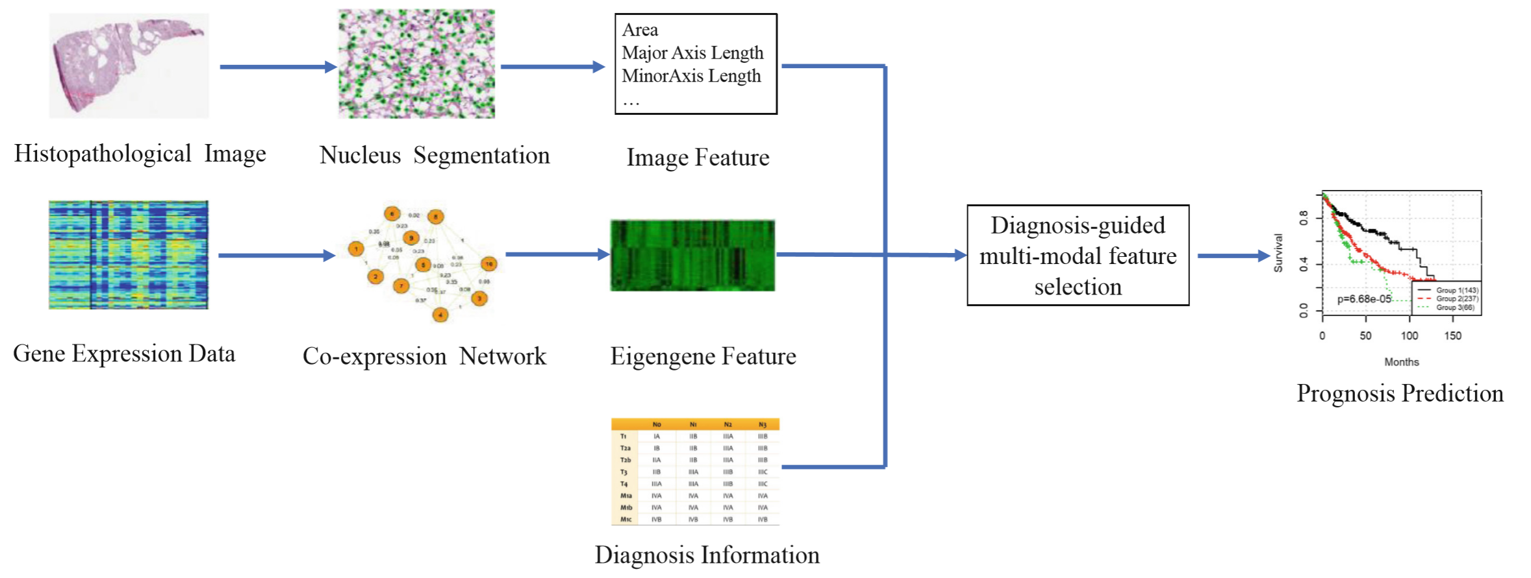
Background
Multiple biomarkers can be used to predict the disease status more accurately, and features can be high dimensional
Current feature selection method (e.g. LASSO) doesn’t consider the relationship between different modalities
Contribution: develop a multi-modal feature selection method (DGM2FS) to discover relevant imaging and genomic risk factors combined with diagnosis for survival analysis

Slide 3
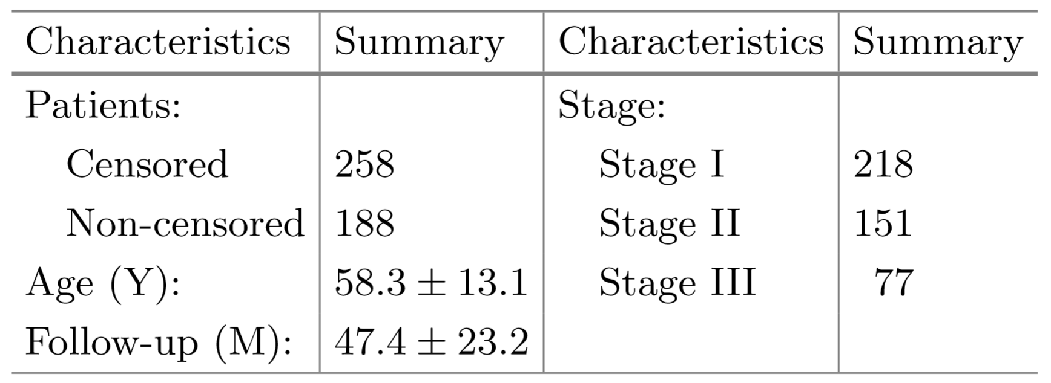
Dataset
Using lung squamous cell carcinoma (LUSC) dataset
446 patients are included, collected data of:
H&E stained whole-slide images
Diagnosis information: TNM staging
gene expression profile
corresponding survival information (i.e., survival status, survival time)

Slide 4
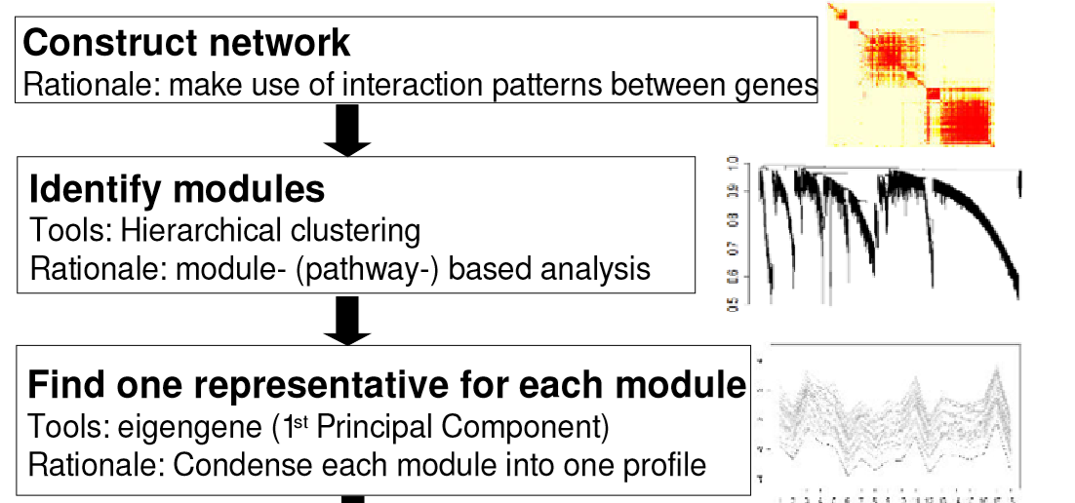
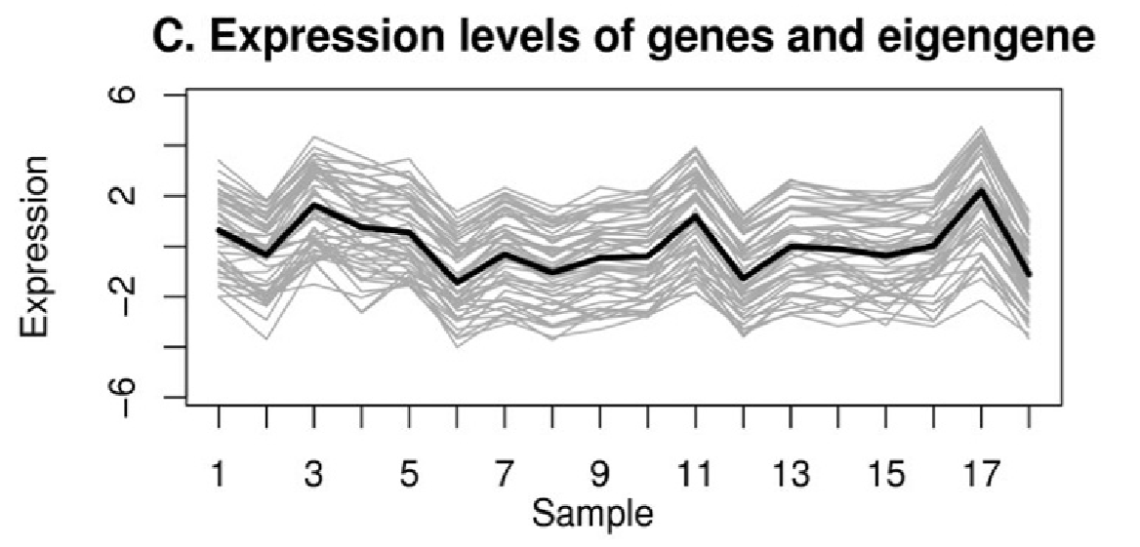
Feature extraction
Imaging features:
Seven cell-level features are extracted: nuclei area, the major and minor axis length of cell nucleus, the ratio of major axis length to minor axis length, and mean, maximum, and minimum distances to its neighboring nuclei.
For each cell-level feature, a 10-bin histogram and ﬁve statistics (i.e., mean, SD, skewness, kurtosis, and entropy) are used to aggregate the cell-level features into patient-level features
Genomic features:
Diagnosis features: TNM staging

Slide 5
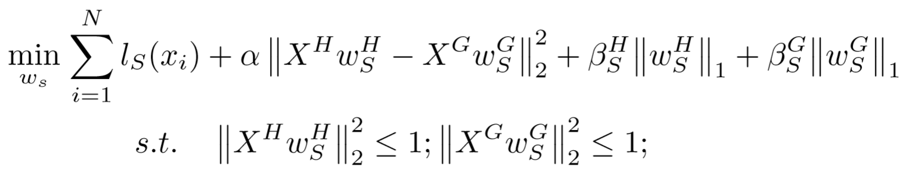
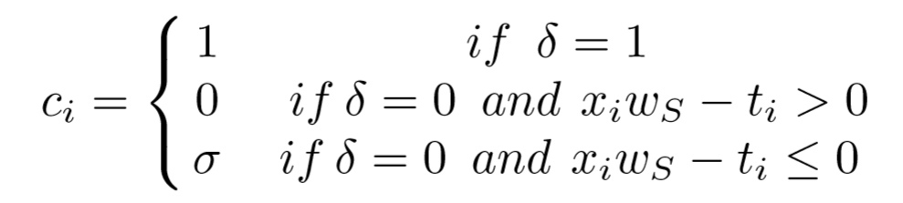

Imaging-genomic feature selection
Weighted regression term: where
Minimize the distance between the projections of imaging and genomic features
L1 Regularization

Slide 6
Imaging-genomic feature selection with Diagnosis Guidance
Patients’ diagnosis and prognosis (survival prediction) are correlated
Use diagnosis prediction as a separate task (multi-task learning)
Idea: learning the relationship between the diagnosis and prognosis tasks can boost the prognosis prediction performance

Slide 7
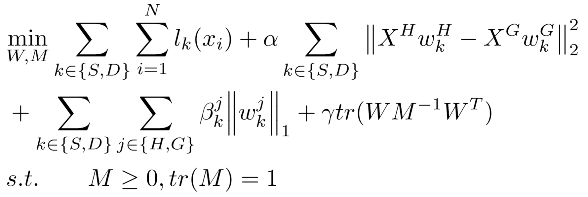
Imaging-genomic feature selection with Diagnosis Guidance
Multitask regression term
Minimize the distance between the projections of imaging and genomic features
L1 Regularization
Task relationship learning term, where M is deﬁned as a task covariance matrix

Slide 8
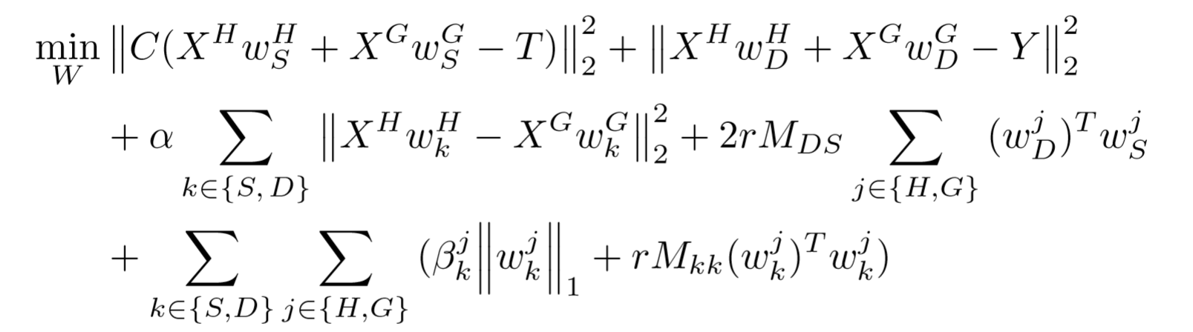

Optimization
Alternating strategy to optimize W and M
Iterative update to get optimal W
Update M using closed form solution
Repeat the two steps until W, M converge to ﬁxed value

Slide 9
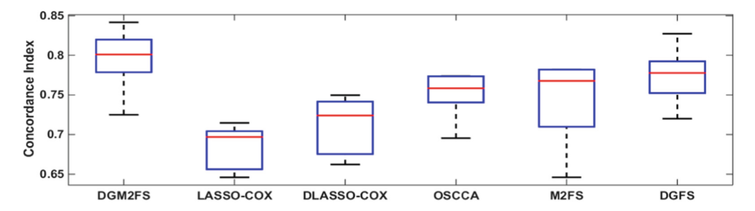
Result
LASSO-Cox: Use the LASSO method for variable selection in the Cox model
DLasso-Cox: add the diagnosis information as a feature to the multi-modal data
OSCCA: a multi-modal feature selection method for survival analysis without the guidance of diagnosis knowledge
M2FS: ablation study, missing task relationship learning term
DGFS: ablation study, missing projection term
Concordance Index (CI): fraction of all pairs of patients whose survival risks are correctly ordered on the testing set

Slide 10
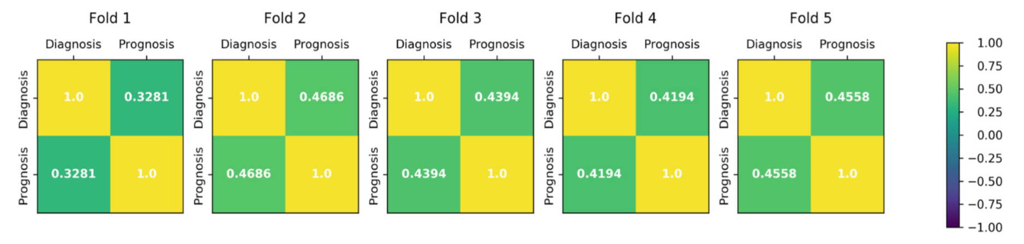
Result
The correlation coeﬃcient matrix between the diagnosis and prognosis tasks for each fold of cross-validation learned by DGM2FS

Slide 11
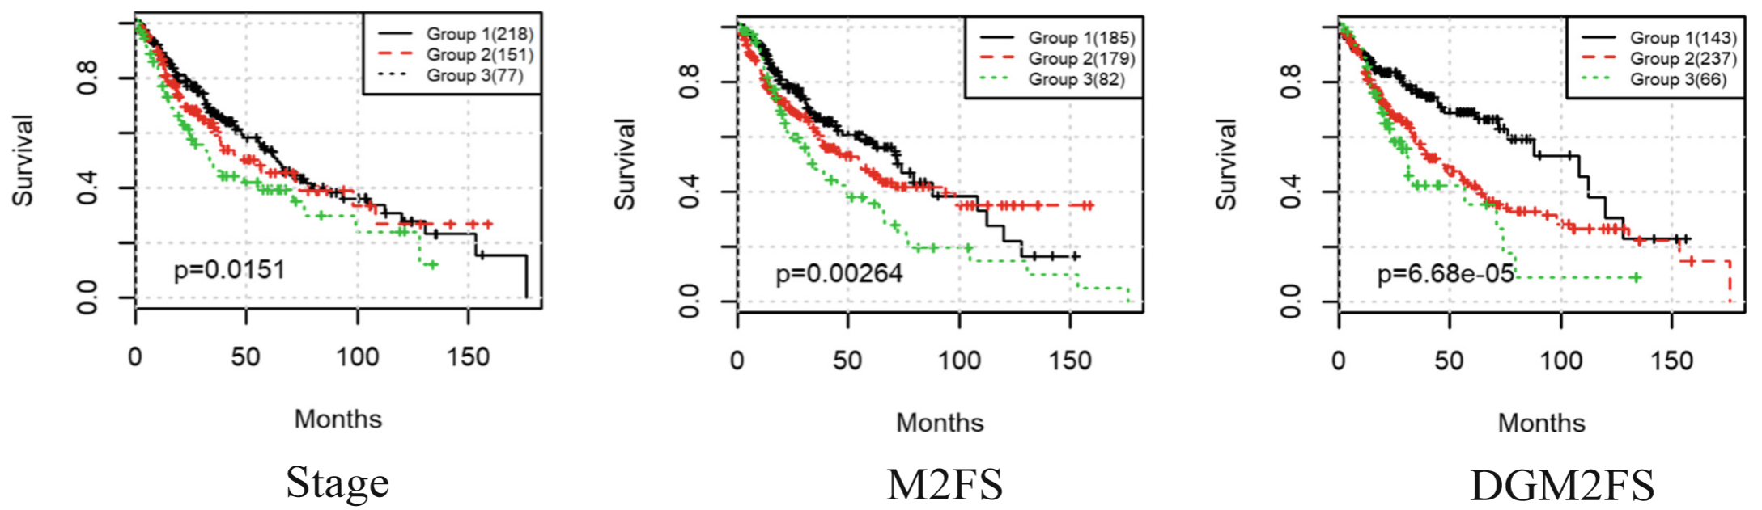
Result
Using KMeans to aggregate the patients into 3 subgroups based on the selected features
The proposed DGM2FS method could achieve superior stratiﬁcation performance than the competitors

Slide 12
Conclusion
Propose a multi-modal feature selection method that can identify survival associated biomarkers from both histopathological image and gene expression data
Use diagnosis information to guide the feature selection process

